Slide 1
VIP: CPT Project
CPT data clustering using Machine Learning algotithms
& the exploration of the deep learning methods
---Abhijat Chauhan, Ruikang Li and Ramsha Aasim
Guided by Chenying Liu

Slide 2
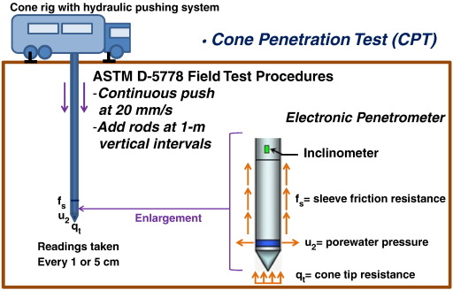
What is CPT and how does it work?
Cone penetration testing (CPT) is a means of examining soil types at multiple depths beneath a site of interest.
(Ku, et.al, 2016)
Notes:
Ruikang

Slide 3
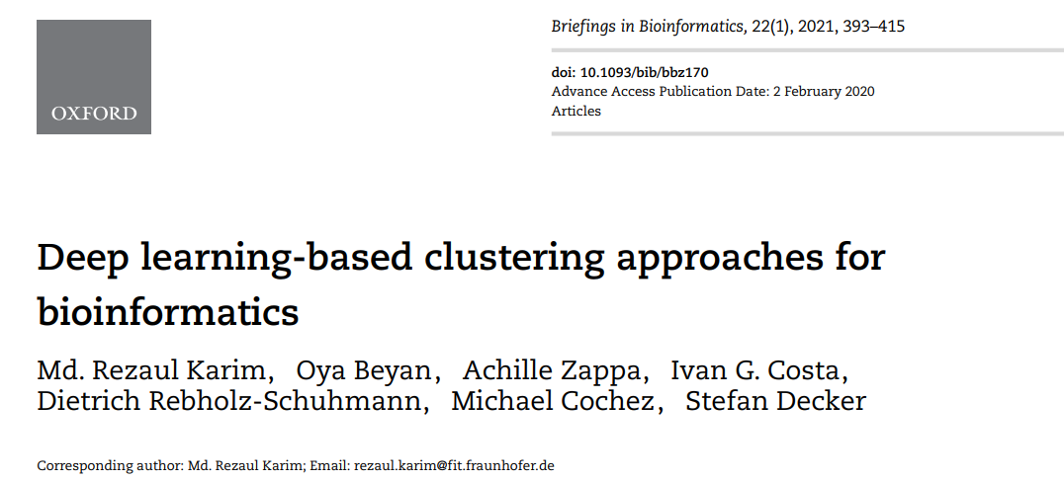
Primary Research Paper References
(Karim et al, 2021)

Slide 4
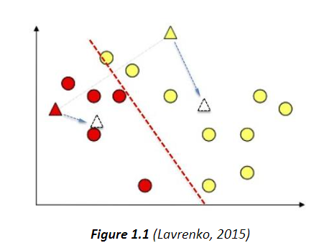
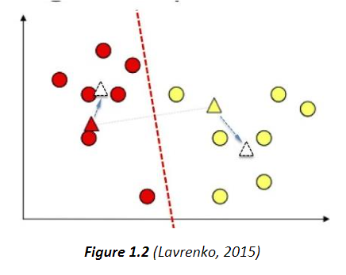
Clustering: K-Means
Parameters: Number of clusters
Geometric Evaluation: Distances between points
Pros (Karim et al, 2021)
Can scale to a large sample size
Simple to understand and implement
Linear complexity O(n), so relatively fast in runtime
Cons (Karim et al, 2021)
Clustering results are very dependent on parameter K (number of clusters, parameter in K-means)
Assumes that each cluster is equal-sized, which may not always work in the real world
Density-based clusters are not represented that well. This allows for clusters with scattered samples.
Figures
Figure 1.1
Starting iteration of the algorithm, k = 2 clusters (red and yellow)
Dotted line is decision boundary, white triangles are calculated centroids for each cluster, and the colored triangles are the core points (temporary centroid points)
Figure 1.2
The calculated centroids from the previous iteration become the centroid points for the new cluster, in which case you repeat the steps and update the decision boundary.
Notes:
https://academic.oup.com/bib/article/22/1/393/5721075
https://towardsdatascience.com/the-5-clustering-algorithms-data-scientists-need-to-know-a36d136ef68
Figure 1.1 shows the starting iteration of the algorithm, where k is initialized to two clusters shown here, with two random core points (red triangle and yellow triangle). A line that is equidistant to the triangle points is the decision boundary, by which the points are then assigned to the cluster based on which core point they are closest to. The centroids are also calculated -the white triangles are the calculated centroids for their respective clusters.
Figure 1.2 shows a second iteration where the updated centroids are now colored, a new decision boundary is drawn, and the points are re-clustered and recolored. New centroids are calculated again for the next iteration.
Figure 1.3 is just a representation of the subsequent iterations that repeat the steps mentioned from Figure 1.1 and Figure 1.2.
Figure 1.4 shows that after numerous iterations, the centroids start to converge and the clusters are kept the same. This is an indication that all the points have been considered and clustered properly, and the K-Means Algorithm has finished.

Slide 5
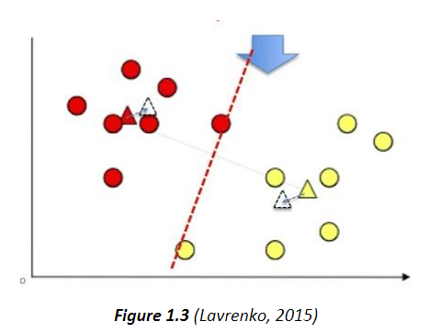
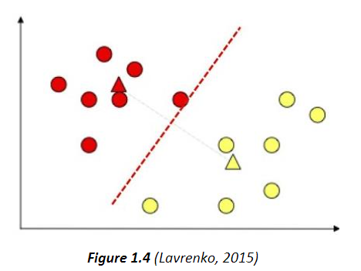
Clustering: K-Means
Parameters: Number of clusters
Geometric Evaluation: Distances between points
Pros
Can scale to a large sample size
Simple to understand and implement
Linear complexity O(n), so relatively fast in runtime
Cons [3]
Clustering results are very dependent on parameter K (number of clusters, parameter in K-means)
Assumes that each cluster is equal-sized, which may not always work in the real world
Density-based clusters are not represented that well. This allows for clusters with scattered samples.
Figures
Figure 1.3
Continue to iterate and loop, repeating the steps mentioned previously.
Figure 1.4
The centroids start to converge, or not change beyond a certain threshold after numerous iterations.
Notes:
https://academic.oup.com/bib/article/22/1/393/5721075
https://towardsdatascience.com/the-5-clustering-algorithms-data-scientists-need-to-know-a36d136ef68
Figure 1.1 shows the starting iteration of the algorithm, where k is initialized to two clusters shown here, with two random core points (red triangle and yellow triangle). A line that is equidistant to the triangle points is the decision boundary, by which the points are then assigned to the cluster based on which core point they are closest to. The centroids are also calculated -the white triangles are the calculated centroids for their respective clusters.
Figure 1.2 shows a second iteration where the updated centroids are now colored, a new decision boundary is drawn, and the points are re-clustered and recolored. New centroids are calculated again for the next iteration.
Figure 1.3 is just a representation of the subsequent iterations that repeat the steps mentioned from Figure 1.1 and Figure 1.2.
Figure 1.4 shows that after numerous iterations, the centroids start to converge and the clusters are kept the same. This is an indication that all the points have been considered and clustered properly, and the K-Means Algorithm has finished.

Slide 6
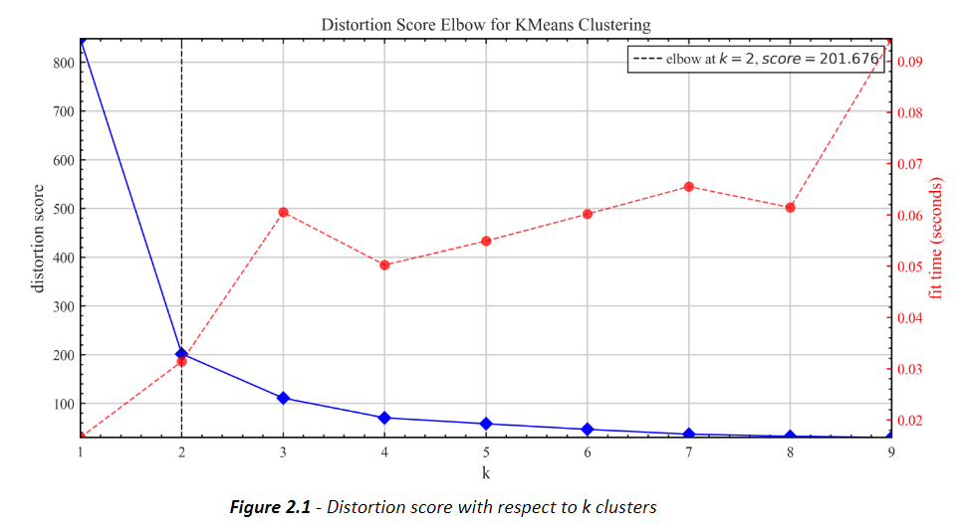
K-means: Estimation of K
Distortion Score
Figure 2.1 – Distortion score with respect to k clusters
Notes:
1.Distortion Score (Figure 2.1):This is a measure of the closeness of data points in a cluster to their mean. It is the sum of squared error (SSE) of all data points in a cluster from their mean. With increasing number of clusters, this score decreases at first rapidly as the model fits better, but then as the optimum point is crossed, starts to overfit and decrease linearly. Thus, the elbow point is the optimum number of clusters, which is k = 2 in our case.
2.Silhouette Score (Figure 2.2): The elbow score is sometimes not accurate since it is hard to pinpoint the elbow. Thus, we can confirm our k value from silhouette score. This score is higher when the intra-cluster distance is minimum, and the inter-cluster distance is maximum for the number of clusters. Thus, its highest value corresponds to the optimum number of clusters, which in our case is like elbow method, i.e., k = 2.

Slide 7
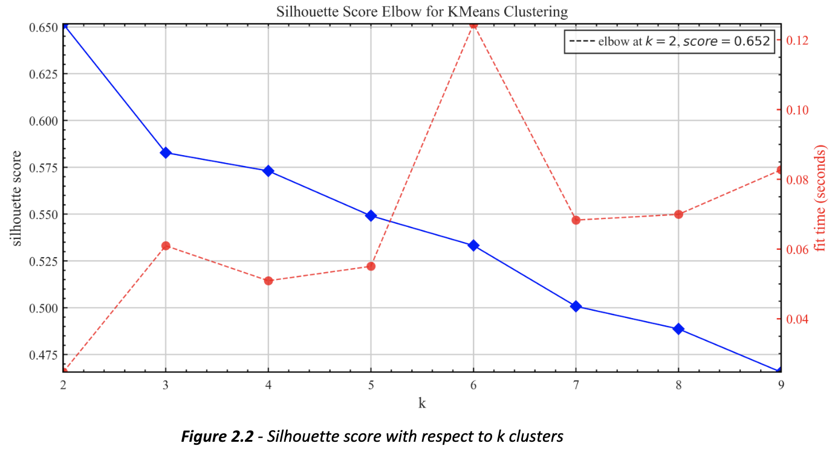
K-means: Estimation of K
Silhouette Score
Figure 2.2 – Silhouette score with respect to k clusters
Notes:
1.Distortion Score (Figure 2.1):This is a measure of the closeness of data points in a cluster to their mean. It is the sum of squared error (SSE) of all data points in a cluster from their mean. With increasing number of clusters, this score decreases at first rapidly as the model fits better, but then as the optimum point is crossed, starts to overfit and decrease linearly. Thus, the elbow point is the optimum number of clusters, which is k = 2 in our case.
2.Silhouette Score (Figure 2.2): The elbow score is sometimes not accurate since it is hard to pinpoint the elbow. Thus, we can confirm our k value from silhouette score. This score is higher when the intra-cluster distance is minimum, and the inter-cluster distance is maximum for the number of clusters. Thus, its highest value corresponds to the optimum number of clusters, which in our case is like elbow method, i.e., k = 2.

Slide 8
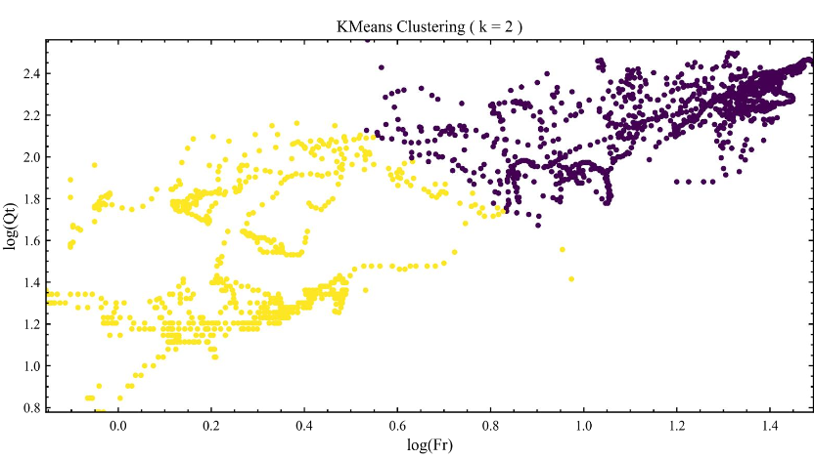
K-means: Results (setting k = 2)
Resulting Clusters (Figure 3.1)
Figure 3.1 – Points in k = 2 clusters

Slide 9
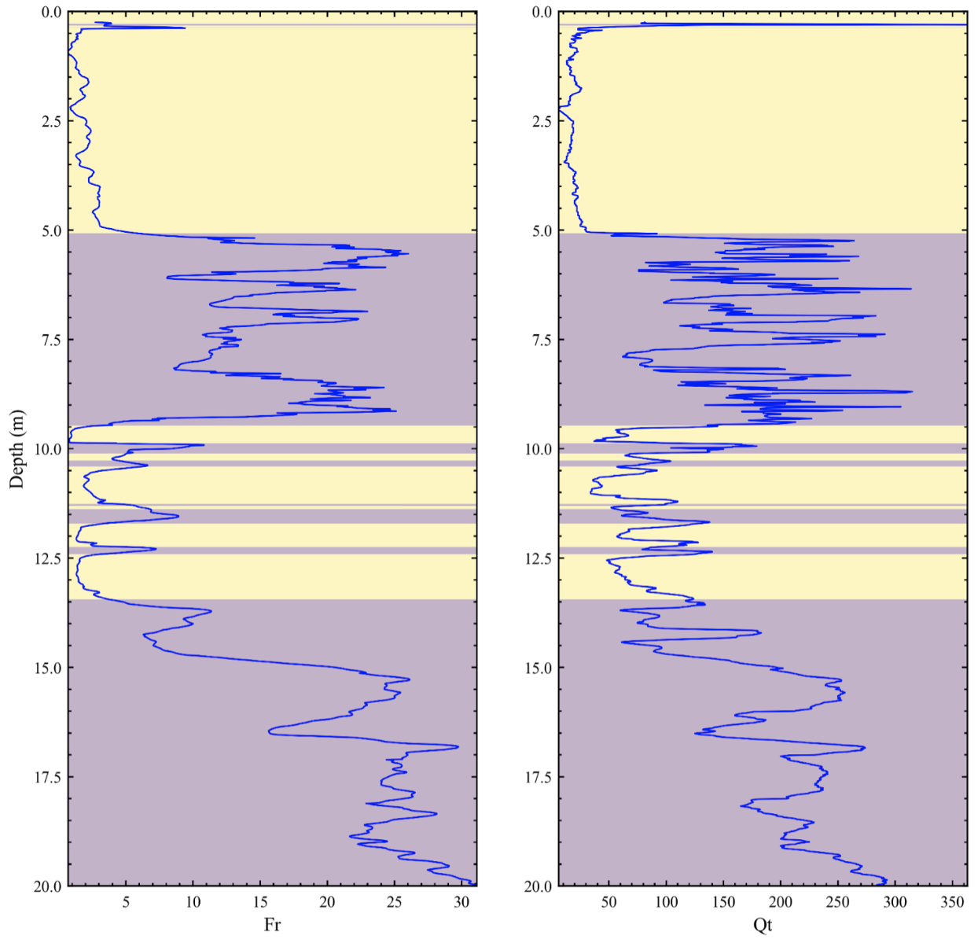
K-means: Results (setting k = 2)
Soil Layering (Figure 3.2)
Figure 3.2 - Layering using 2 clusters, with respect to Depth, Friction (Fr) and Tip (Qt)

Slide 10
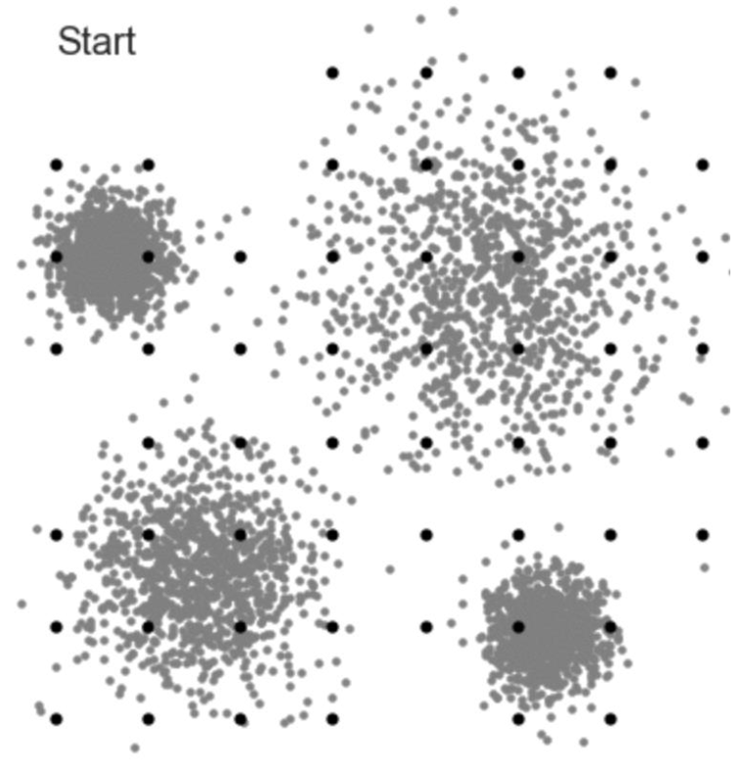
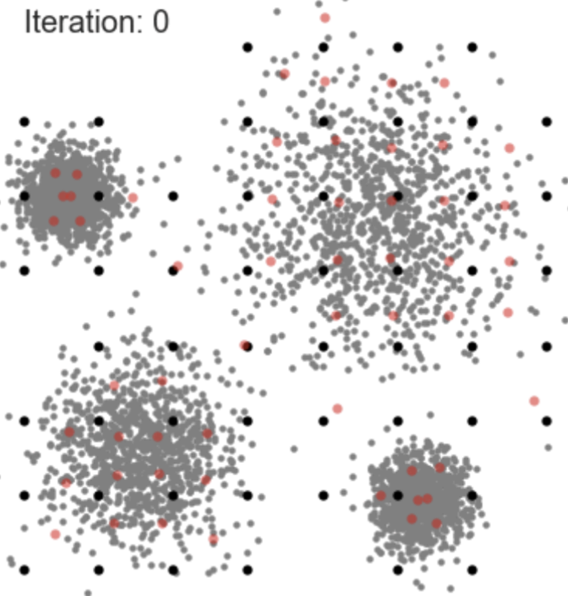
Clustering: Mean-Shift
Similar to K-Means, except it does not preset k number of clusters.
Parameters
Radius/Bandwidth
Geometric Evaluation: Distances between points
Pros (Mean Shift Intro, 2016)
Does not require a predetermined number of clusters
Identifies outliers as noises – good for avoiding overfitting
Cons (Karim et al, 2021)
Does not work well with clusters that have varying densities: i.e. different distance thresholds
Figure 4.1 - Start with a set of points in a graph, black dots as centroids (Geif, 2018)
Figure 4.2 - Recalculate the centers. (Geif, 2018)
Notes:
https://www.youtube.com/watch?v=3ERPpzrDkVg
Radius is the search size from the current point being explored.
Bandwidth is the number of points to be included in a search radius for a valid cluster to form.

Slide 11
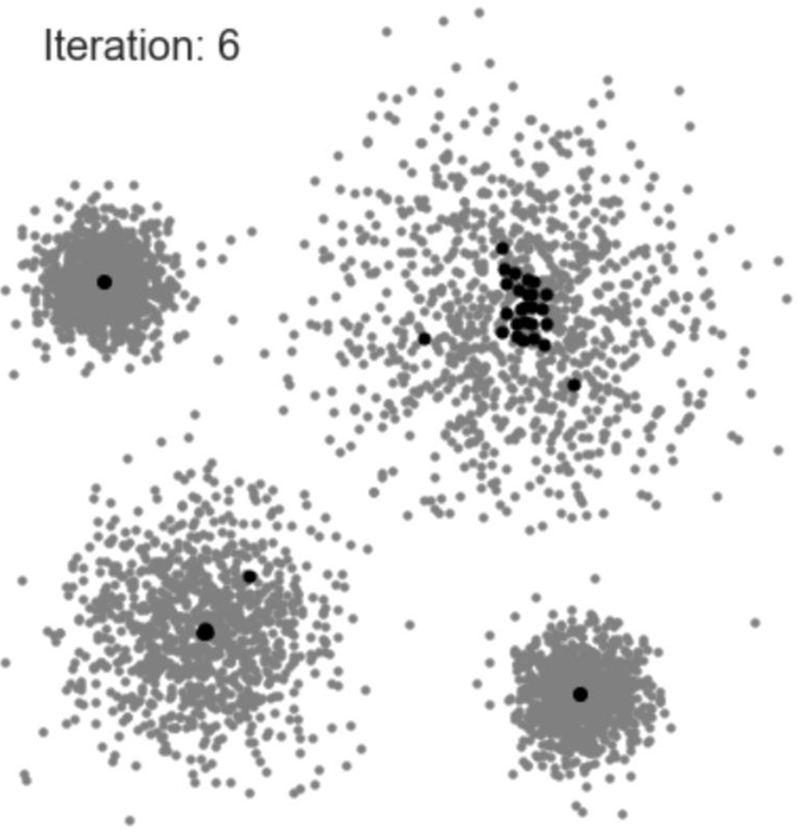
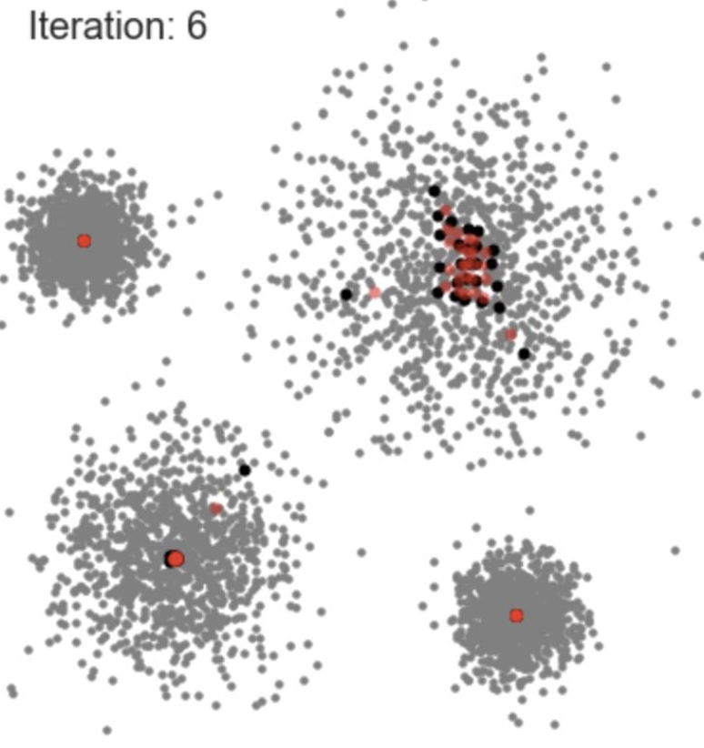
Clustering: Mean-Shift
Similar to K-Means, except it does not preset k number of clusters.
Parameters
Radius/Bandwidth
Geometric Evaluation: Distances between points
Pros (Mean Shift Intro, 2016)
Does not require a predetermined number of clusters
Identifies outliers as noises – good for avoiding overfitting
Cons (Karim et al, 2021)
Does not work well with clusters that have varying densities: i.e. different distance thresholds
Figure 4.3 - Using recalculated centers, continue shifting the centroids (black dots) and adding points to their respective clusters along the way. (Geif, 2018)
Figure 4.4 - Recalculate the centers. (Geif, 2018)
Notes:
https://www.youtube.com/watch?v=3ERPpzrDkVg
Radius is the search size from the current point being explored

Slide 12
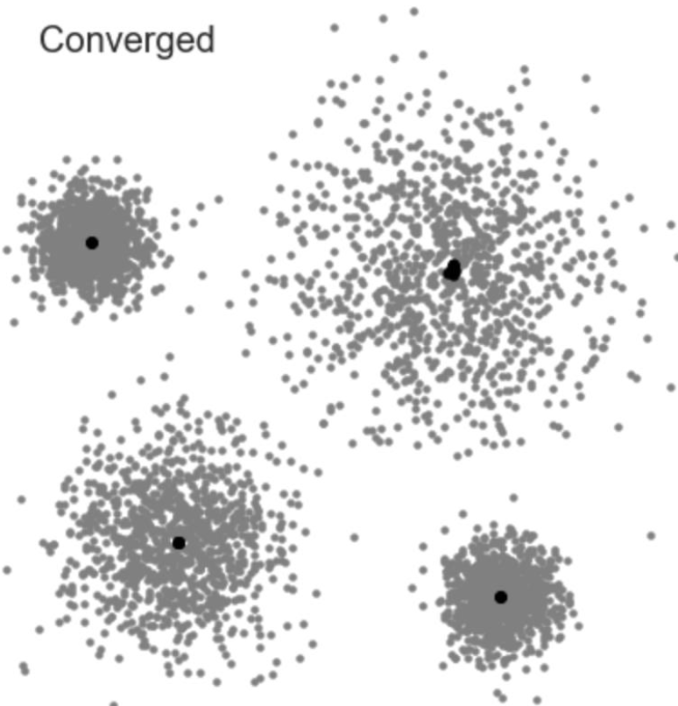
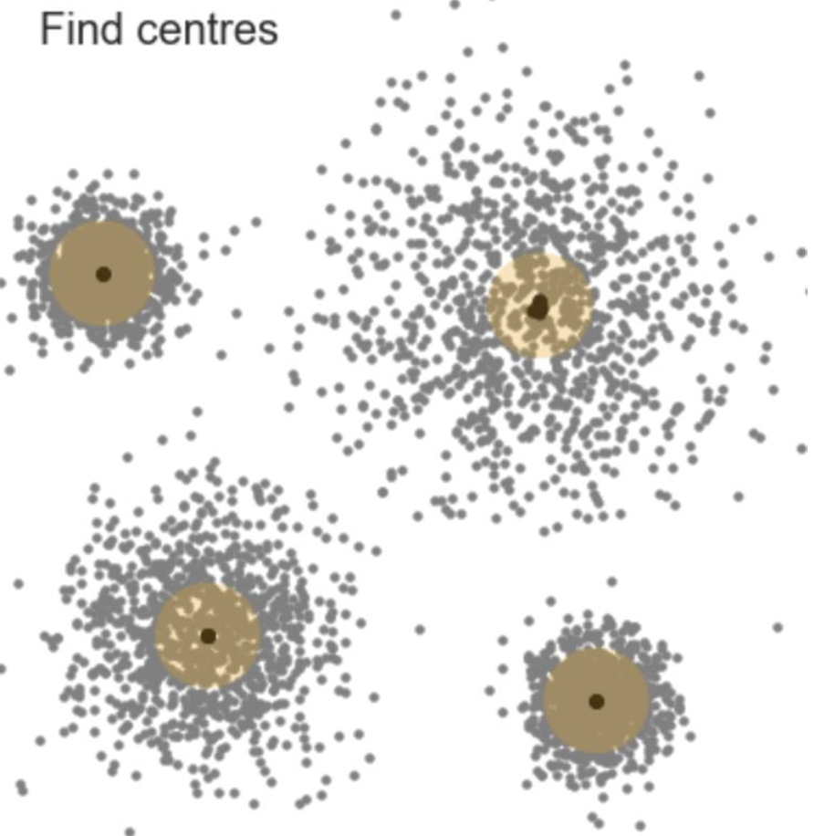
Clustering: Mean-Shift
Similar to K-Means, except it does not preset k number of clusters.
Parameters
Radius/Bandwidth
Geometric Evaluation: Distances between points
Pros (Mean Shift Intro, 2016)
Does not require a predetermined number of clusters
Identifies outliers as noises – good for avoiding overfitting
Cons (Karim et al, 2021)
Does not work well with clusters that have varying densities: i.e. different distance thresholds
Figure 4.5 - Centroids (black dots) converged. (Geif, 2018)
Figure 4.6 - Locate the center of those centroids at each cluster. (Geif, 2018)
Notes:
https://www.youtube.com/watch?v=3ERPpzrDkVg
Radius is the search size from the current point being explored

Slide 13
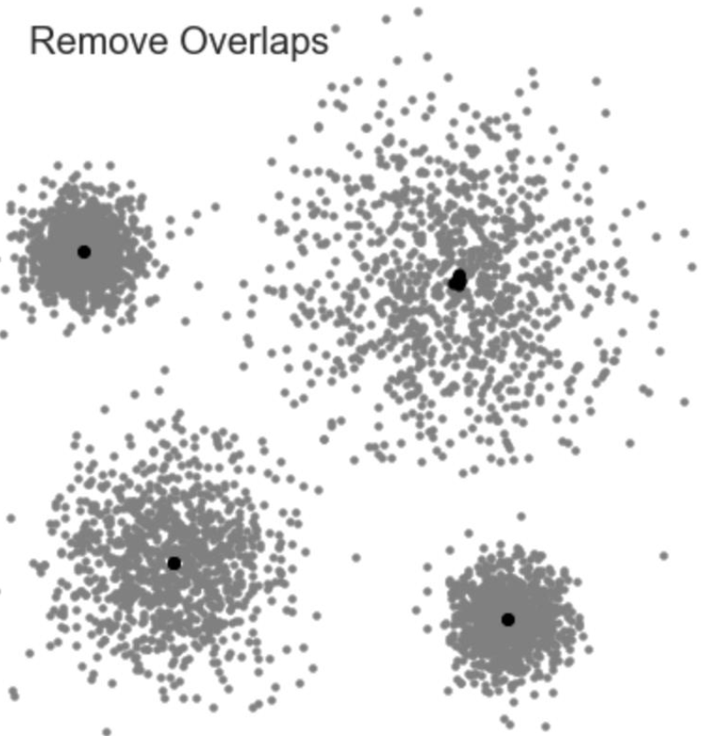
Clustering: Mean-Shift
Similar to K-Means, except it does not preset k number of clusters.
Parameters
Radius/Bandwidth
Geometric Evaluation: Distances between points
Pros (Mean Shift Intro, 2016)
Does not require a predetermined number of clusters
Identifies outliers as noises – good for avoiding overfitting
Cons (Karim et al, 2021)
Does not work well with clusters that have varying densities: i.e. different distance thresholds
Figure 4.7 - Remove the smaller clusters overlapping the big clusters. (Geif, 2018)
Notes:
https://www.youtube.com/watch?v=3ERPpzrDkVg
Radius is the search size from the current point being explored

Slide 14
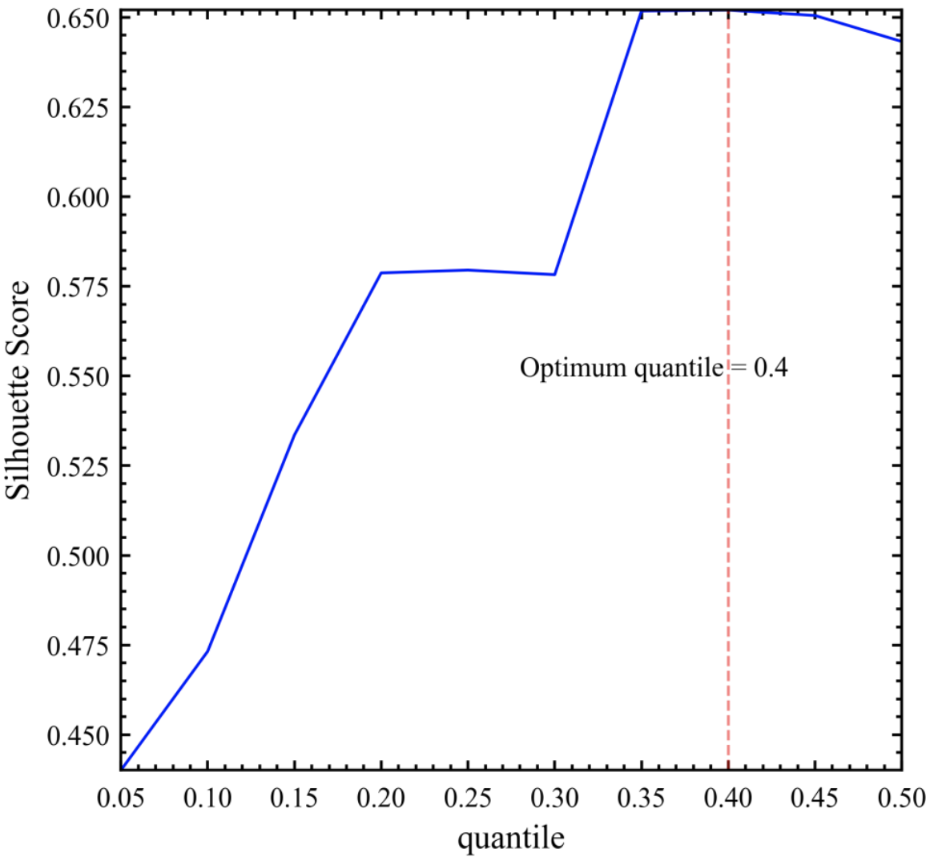
Mean-Shift: Choosing Radius/Bandwidth
Silhouette Method (Figure 5)
Figure 5 – Choosing optimal quantile, or the radius
Notes:
For a refresher on Silhouette Method, please refer to slide 6.
Just like we used the Elbow Method and Silhouette Score to estimate the optimal k clusters for K-Means, we used the Silhouette Score to find the optimal radius, or quantile.

Slide 15
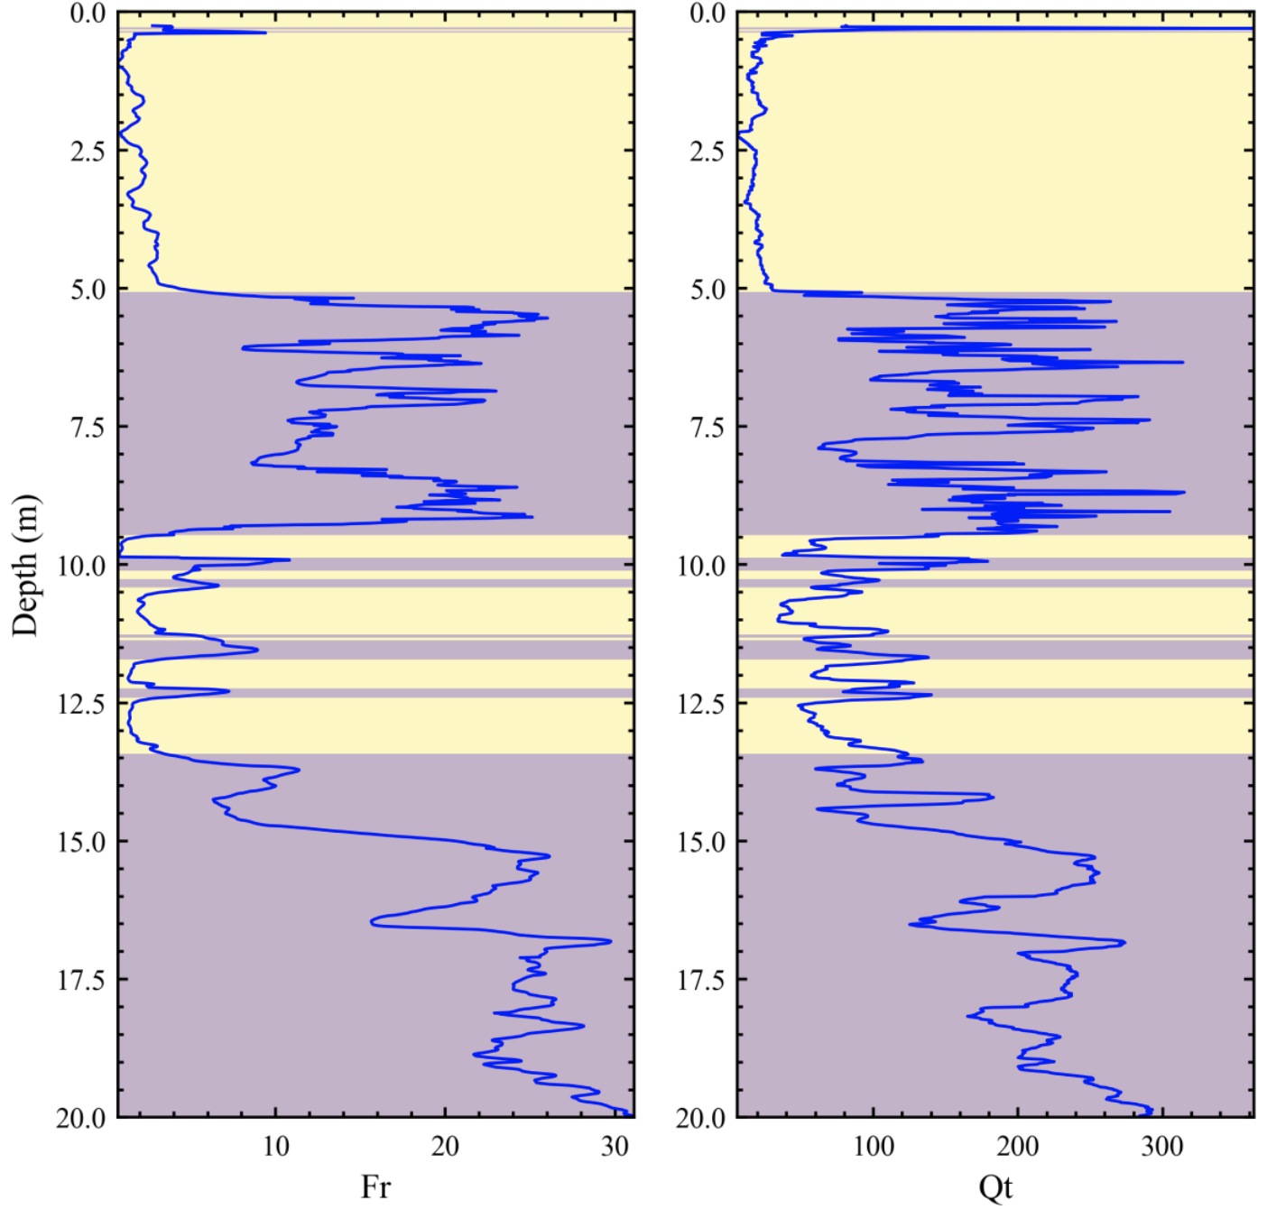
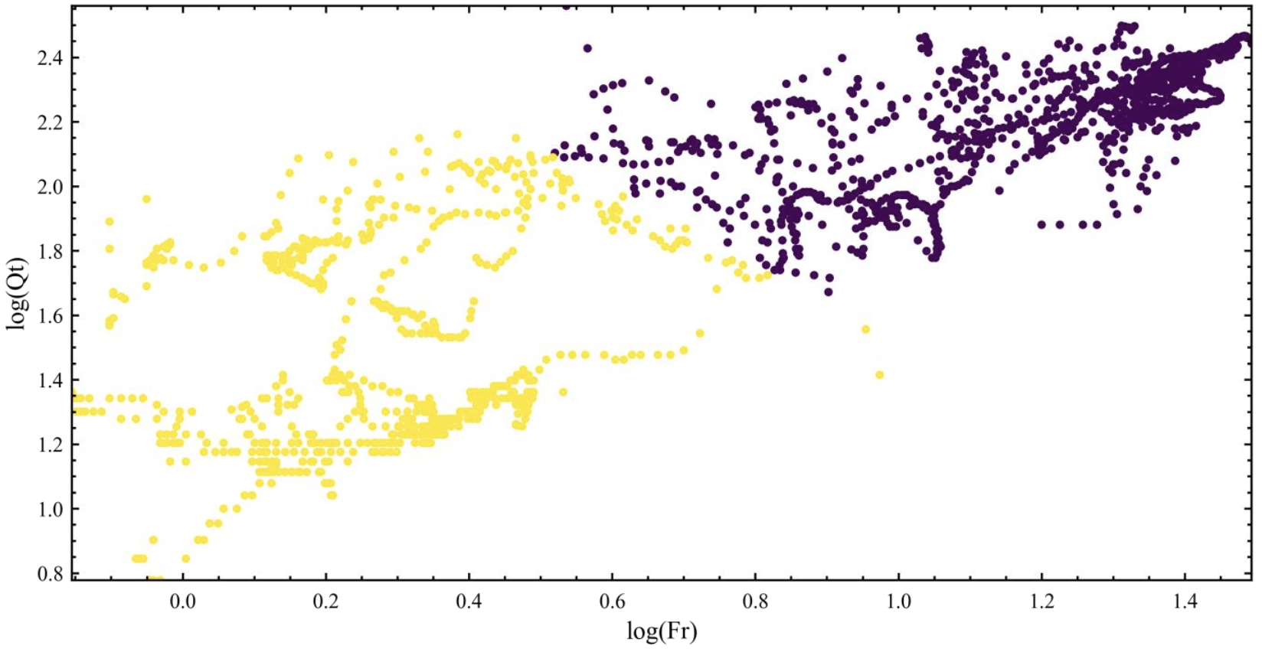
Mean-Shift: Results
estimates the number of clusters on our dataset to be:
k = 2
radius = 0.4
Figure 6.1 – Clusters from Mean-Shift
Figure 6.2 – Layering from Mean-Shift

Slide 16
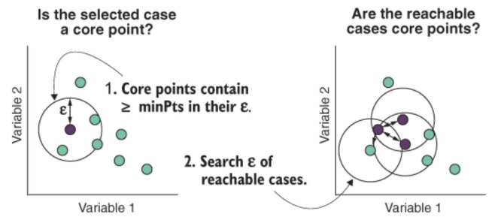
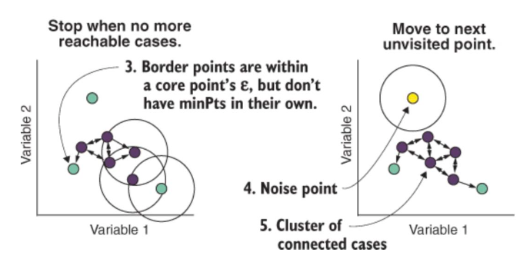
Clustering: DBSCAN
Density-Based Spatial Clustering of Applications with Noise ==> DBSCAN
Parameters
Neighborhood size – How dense we want the clusters to be, also known as minimum points in area
Distance threshold
Geometric Evaluation: Distances between nearest points
Pros (Karim et al, 2021)
Does not require a predetermined number of clusters
Identifies outliers as noises – good for avoiding overfitting
Good for identifying elaborately shaped clusters, arbitrarily size clusters
Cons (Karim et al, 2021)
Does not work well with clusters that have varying densities: i.e. different distance thresholds
Quadratic computational complexity
Struggles to separate nearby clusters – room for error is low
Figure 7.1 (Chapter 18 clustering based, 2021)
Figure 7.2 (Chapter 18 clustering based, 2021)
Notes:
https://academic.oup.com/bib/article/22/1/393/5721075
https://towardsdatascience.com/the-5-clustering-algorithms-data-scientists-need-to-know-a36d136ef68

Slide 17
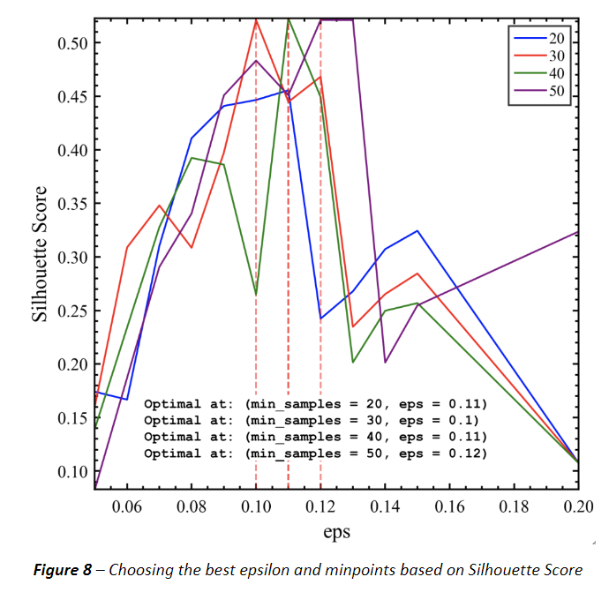
DBSCAN: Choosing max epsilon and minimum points per cluster
Silhouette Method (Figure 8)
Figure 8 – Choosing optimal epsilon and min_pts
Notes:
For a refresher on Silhouette Method, please refer to slide 6.

Slide 18
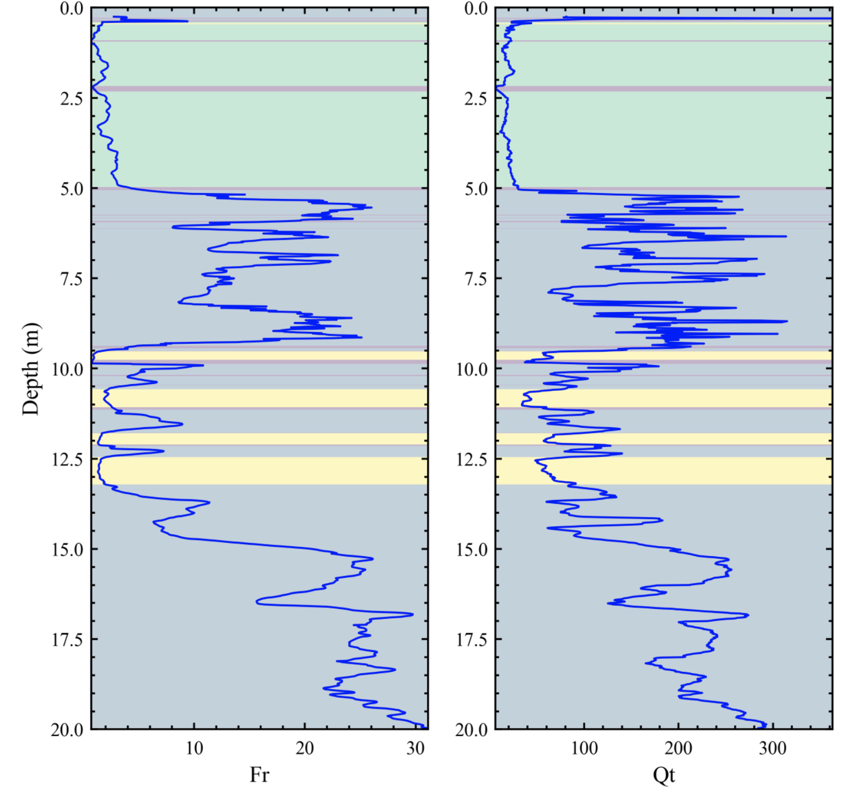
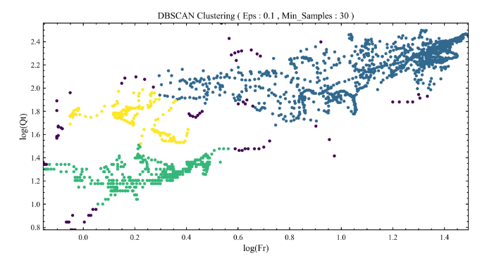
DBSCAN: Results
estimates the number of clusters on our dataset to be
k = 3
eps = 0.1 | min_pts = 30
Figure 9.1 – Clusters from DBSCAN
Figure 9.2 – Layering from DBSCAN

Slide 19
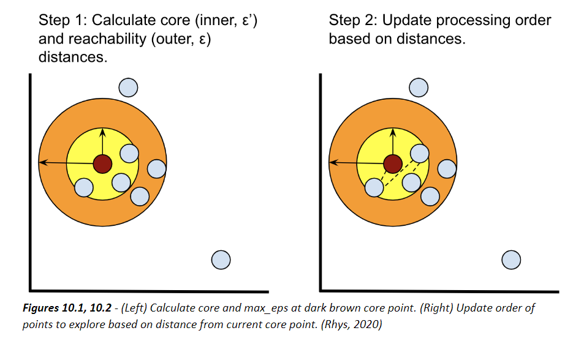
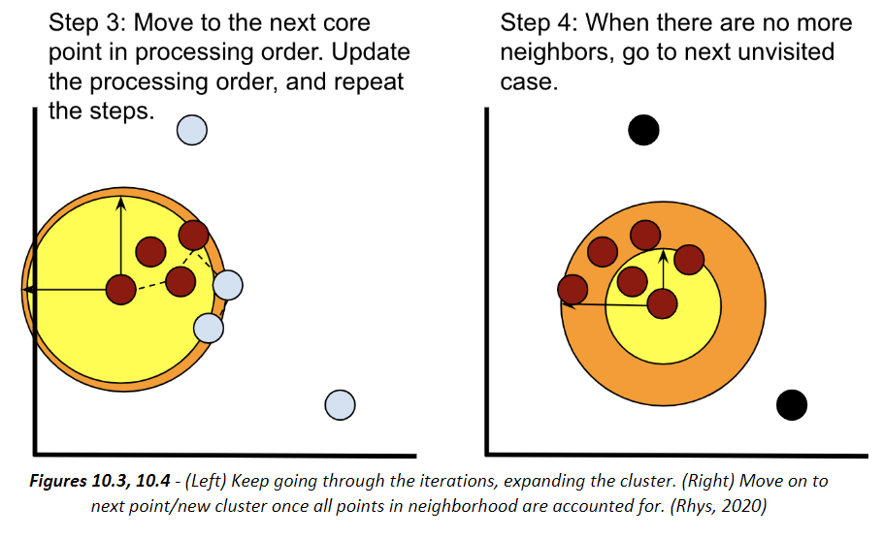
Clustering: OPTICS
Ordering Points to Identify Cluster Structure
Extension of DBSCAN
Parameters: Minimum Cluster Membership: Core distance minimum
Geometric Evaluation: Distances between points
Pros: Same as DBSCAN
Also scalable to large number of samples across clusters
Cons: Same as DBSCAN
Figure 10.1 (Rhys, 2020)
Figure 10.2 (Rhys, 2020)
Notes:
https://towardsdatascience.com/clustering-using-optics-cac1d10ed7a7

Slide 20
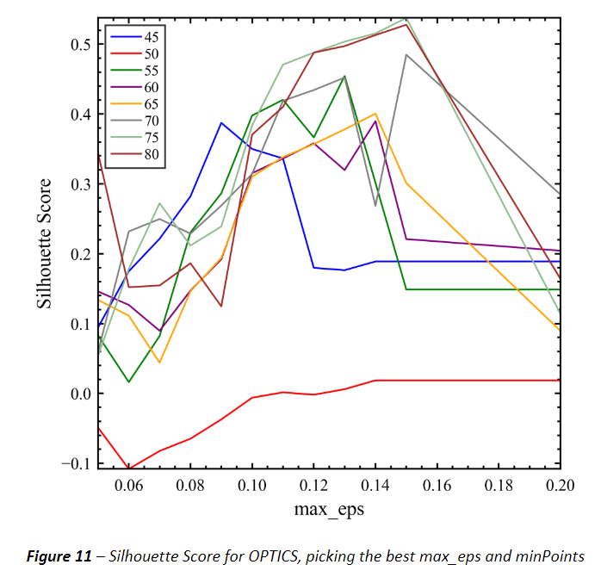
OPTICS: Choosing max epsilon and minimum points per cluster
Figure 11 – Choosing optimal min_pts, with max_eps as guidance
Notes:
For a refresher on Silhouette Score, please refer to slide 6.

Slide 21
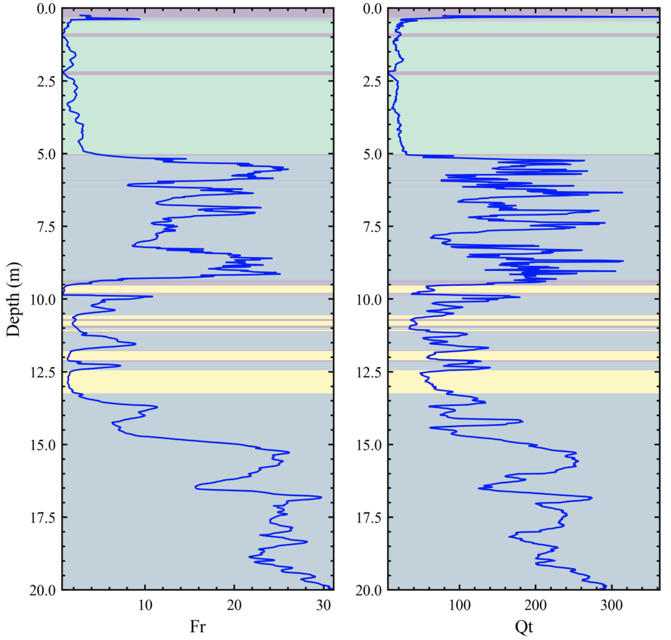
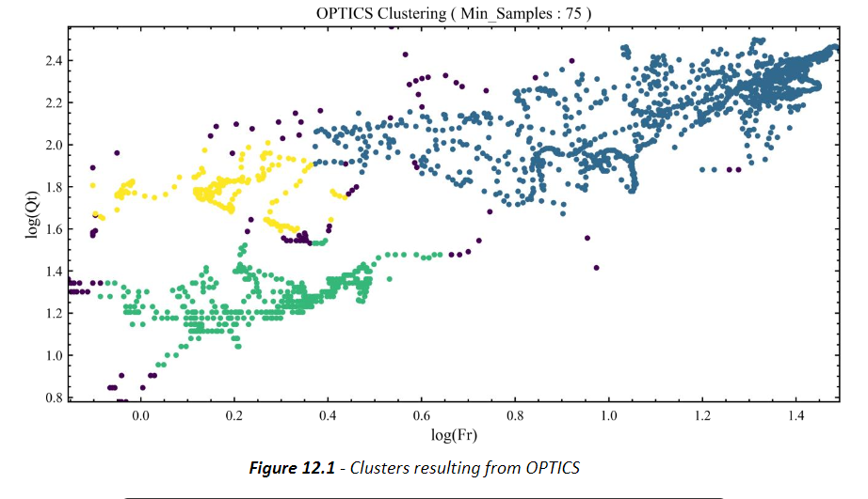
OPTICS: Results
estimates the number of clusters on our dataset to be
k = 3
Hyperparameters
min_samples = 75
max_eps = 0.15
Figure 12.1 – Clusters from OPTICS
Figure 12.2 – Layering from OPTICS

Slide 22
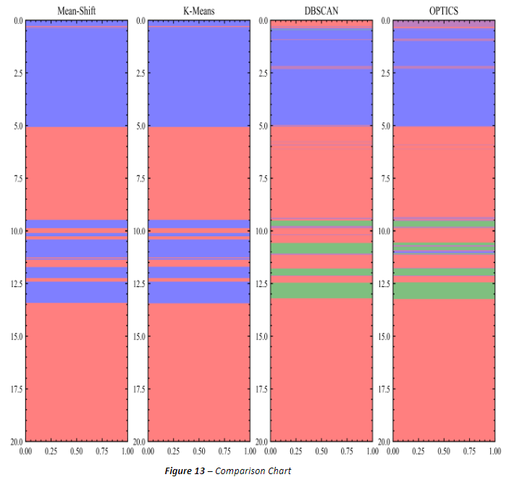
Comparison between different algorithms
Figure 13 – Comparison Chart

Slide 23
Neural Networks with Clustering

Slide 24
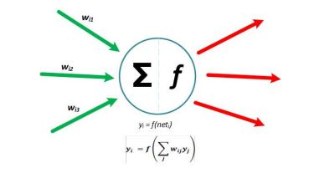
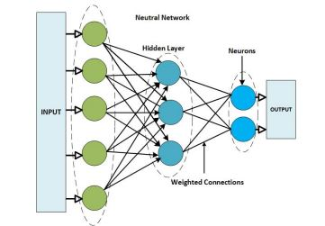
Neural Networks
The history of Artificial Neural Networks dates to the mid-20th century.
They have gained significant popularity in the recent years due to the availability of huge amount of data and computational resources.
They have helped achieve breakthroughs in all fields of science and engineering.
They have been successfully applied to various supervised, unsupervised and reinforcement learning problems.
(HU Dike · 2018)
Notes:
https://towardsdatascience.com/clustering-using-optics-cac1d10ed7a7

Slide 25
Neural Networks
However, typical deep learning setting is fit for supervised learning problems. Unsupervised learning, as in our case of soil stratification identification from the CPT data, is trickier to deal with since we do not have the ground truth to train our model on.
Representation Learning learns informative representation of the data to simplify information extraction for clustering (Yoshua Bengio · 2014)
Notes:
https://towardsdatascience.com/clustering-using-optics-cac1d10ed7a7

Slide 26
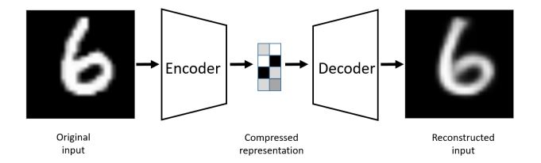
Representation Learning
We make use of Autoencoders (Ilya Tolstikhin · 2018).
Introduced in the 1980s by Hinton and the PDP group (Rumelhart et al· 1986)
They deal with backpropagation in an unsupervised setting.

Slide 27
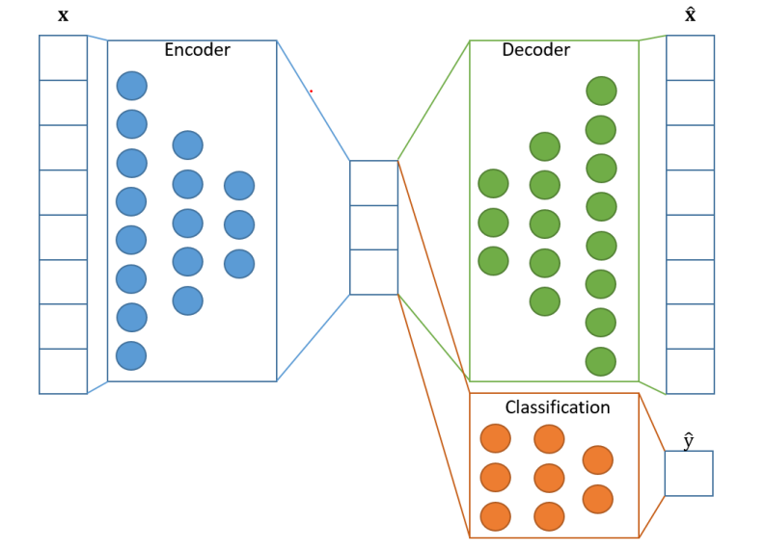
RL with Auto-Encoders
The autoencoder model is usually used for dimensionality reduction.
We only intend to find an alternate transformation of the features that might help us get better clustering results.
The neural network will consist of two parts:
An encoder, consisting of linear and non-linear layers which will find an alternate representation of the data.
A decoder, that attempts to reconstruct the original features from the transformed features. The difference between the reconstructed features and the original features will give us the loss of our transformation, which will be minimized during training.

Slide 28
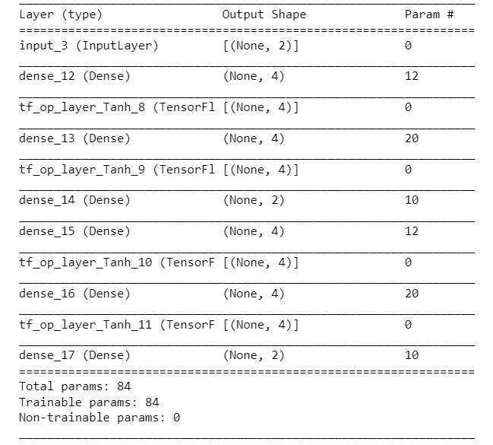
Suggested Model
50 EPOCHS.
Time: 0.009 s

Slide 29
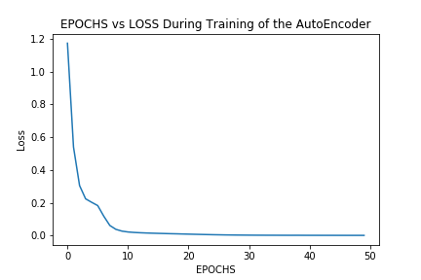
Loss Curve
MSE Loss

Slide 30
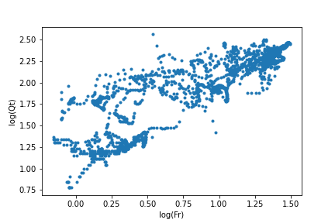
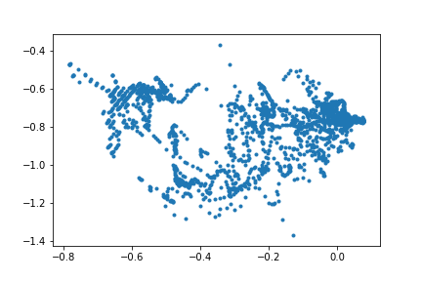
Default vs. Transformed Features

Slide 31
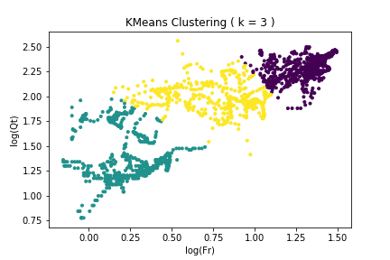
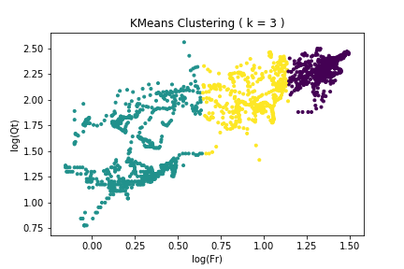
Kmeans on Transformed Data
K-Means on Original Feature Space
K-Means from Transformed Feature Space Projected on Original Feature Space

Slide 32
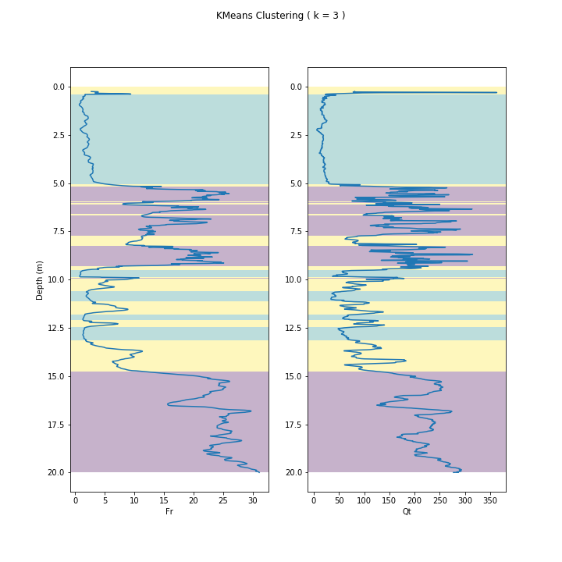
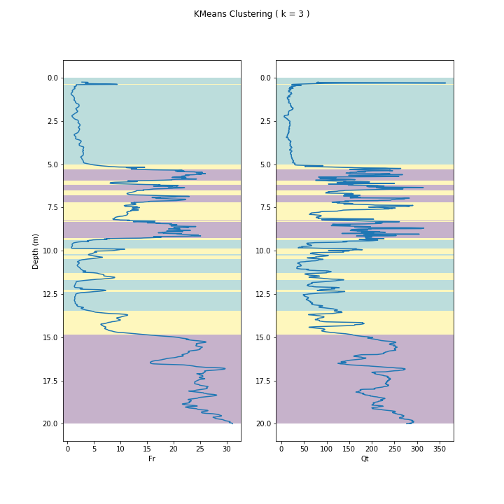
K-Means with Transformed Data
K-Means on Original Feature Space
K-Means from Transformed Feature Space Projected on Original Feature Space

Slide 33
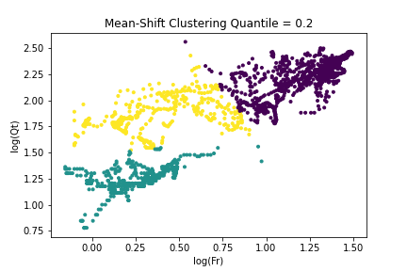
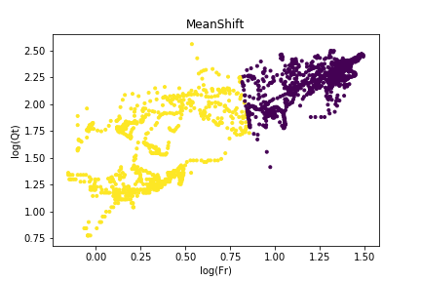
Meanshift on Transformed Data
MeanShift on Original Feature Space
MeanShift from Transformed Feature Space Projected on Original Feature Space

Slide 34
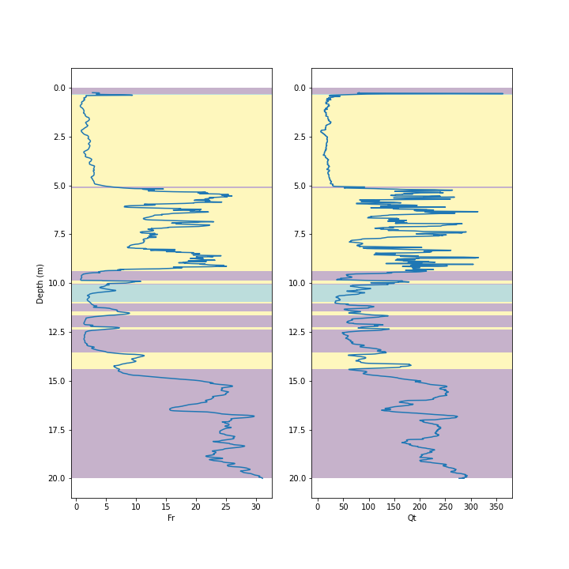
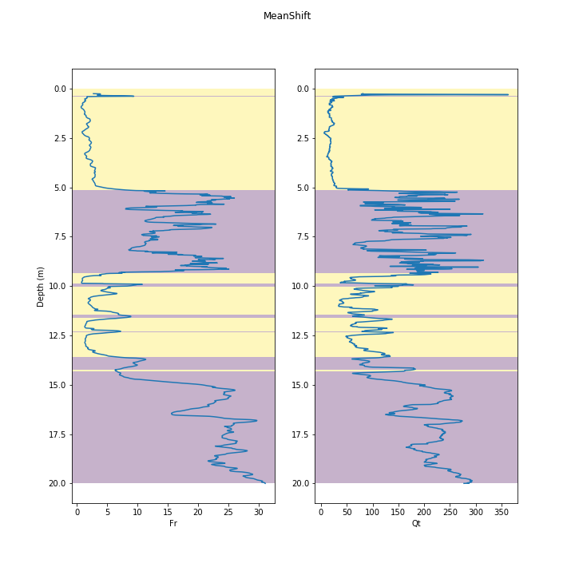
Mean-Shift with Transformed Data
Mean SHift on Original Feature Space
Meanshift from Transformed Feature Space Projected on Original Feature Space

Slide 35
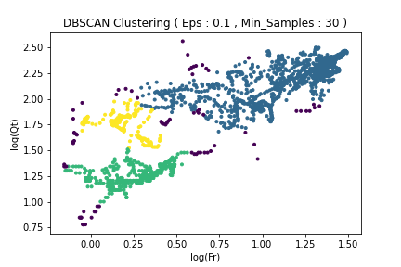
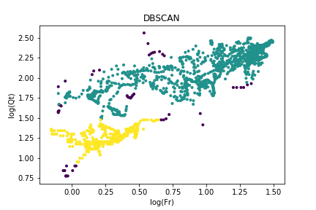
DBSCAN on Transformed Data
DBSCAN on Original Feature Space
DBSCAN from Transformed Feature Space Projected on Original Feature Space

Slide 36
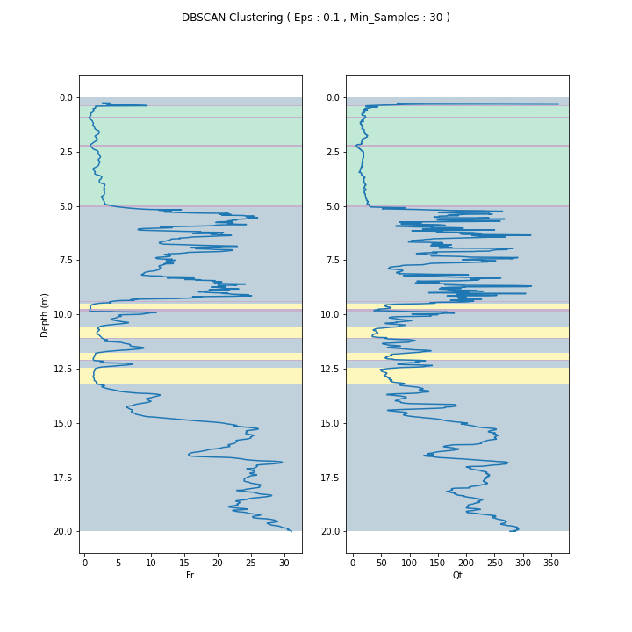

DBSCAN with Transformed Data
DBSCAN on Original Feature Space
DBSCAN from Transformed Feature Space Projected on Original Feature Space

Slide 37

Comparison of Models on transformed Features

Slide 38

Future Goals
Incorporating OPTICS with Neural Network
Uncertainty Quantification Using Results from the selected algorithms
Testing the Developed Model on Test Data
Finishing up the Write-up

Slide 39
References
Ashour, W. M., Mezied, I. A., & Abu-Issa, A. S. (2018). Improving Density-based Clustering using Metric Optimization. International Journal of Computer Applications, 181(21).
Chapter 18 clustering based on density: DBSCAN and OPTICS -machine learning with R, the Tidyverse, and MLR. (2021). https://dev2u.net/2021/06/03/chapter-18-clustering-based-on-density-dbscan-and-optics-machine-learning-with-r-the-tidyverse-and-mlr/
DBSCAN: density-based clustering for discovering clusters in large datasets with noise -Unsupervised Machine Learning. (n.d.). STHDA. Retrieved April 4, 2018,from http://www.sthda.com/english/wiki/wiki.php?id_contents=7940

Slide 40
References
Karim MD, M. R., Beyan, O., Zappa, A., Costa, I. G., Rebholz-Schuhmann, D., Cochez, M., & Decker, S. (2020, February 1). Deep learning-based clustering approaches for bioinformatics (Briefings in Bioinformatics 22; Issue Brief No. 1). Oxford Academic. https://doi.org/10.1093/bib/bbz170
Lavrenko, V. (2015, September). Clustering 6: The k-means algorithm visually [Video]. YouTube.https://www.youtube.com/watch?v=IJt62uaZR-M
Mean Shift Intro - Practical Machine Learning Tutorial with Python p.39 [Video]. (2016, June 29).YouTube. https://www.youtube.com/watch?v=3ERPpzrDkVg

Slide 41
References
Rhys, H. I. (2020). Chapter 18. Clustering based on density: DBSCAN and OPTICS. In Machine Learning with R, the tidyverse, and mlr.
Scikit-learn: Machine Learning in Python, Pedregosa et al., JMLR12, pp. 2825-2830, 2011.
Seif, G. (2018, February 5). The 5 Clustering Algorithms Data Scientists Need to Know. Retrieved April 4, 2022, from https://towardsdatascience.com/the-5-clustering-algorithms-data-scientists-need-to-know-a36d136ef68
Sinclair, C. (2019, January 1). Clustering Using OPTICS. Towards Data Science. Retrieved April 4, 2022,from https://towardsdatascience.com/clustering-using-optics-cac1d10ed7a7

Slide 42

Questions?

